Slide 1



Salary Predictor Web App
Name: Ahmed Hamdi
Id: 221001876
Under supervision :
Dr.Mohamed Elsayeh
Page 01

Slide 2

Project Overview
• Flask web application to predict high-salary jobs
• Based on company rating, founding year, seniority, state, and average salary
• Trained using scikit-learn models and feature selection
Page 02

Slide 3

Code Structure
• Loaded dataset using Pandas and performed initial cleaning
• Extracted relevant columns: Rating, Founded, State, Seniority, avg_salary
• Encoded categorical features using get_dummies
• Created binary target variable: high_salary = 1 if above median
• Split data using train_test_split
Page 03

Slide 4
Feature Selection
• Used SelectKBest for selecting top 5 features
• Score function: f_classif (ANOVA F-test)
• This is a filter-based method
• Transformed training and testing data accordingly
Page 04

Slide 5
Model Training and Evaluation
• Trained multiple classifiers: Logistic Regression, Random Forest, SVC
• Used classification_report to evaluate predictions
• Selected best model based on performance
• Saved final model and feature list using joblib
Page 05

Slide 6
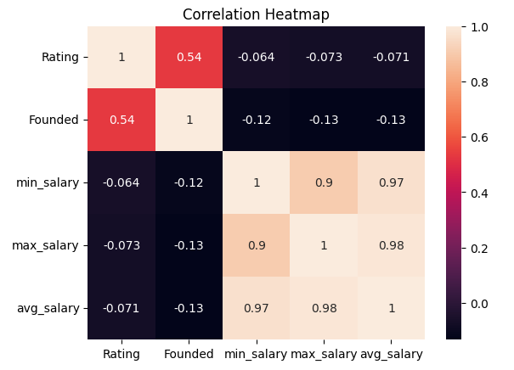
Correlation Heatmap
The heatmap illustrates the correlation between numerical features in the dataset. Strong correlations are found between min_salary, max_salary, and avg_salary. Rating and Founded year show weak correlation with salary, which suggests their limited predictive power.
Page 06

Slide 7
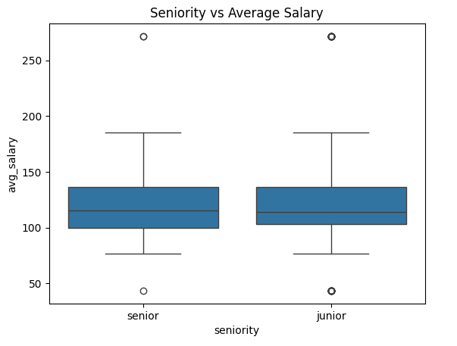
Seniority vs. Average Salary
The boxplot compares the distribution of average salaries between junior and senior roles. Senior positions generally exhibit a higher average salary and wider salary spread. However, there is some overlap suggesting that other factors also influence salary.
Page 07

Slide 8
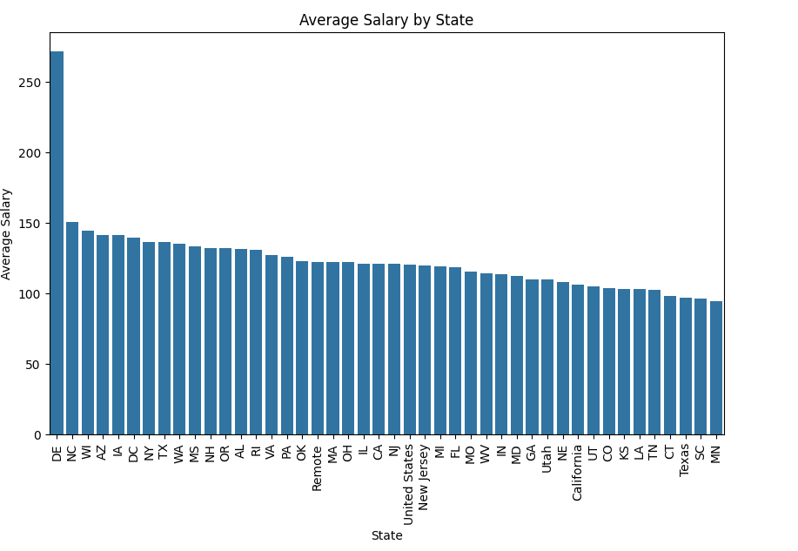
Average Salary by State
The bar chart illustrates how average salaries vary across different states. Delaware and North Carolina lead with the highest average salaries. This analysis reveals geographical trends in salary expectations.
Page 08

Slide 9

• Rating (float)
• Founded (year)
• Seniority (categorical)
• State (categorical)
• Average Salary (float)
Web App
Page 09

Slide 10
• index.html collects form input
• app.py receives and processes input
• Predicts using model.pkl and features.pkl
• Returns result to HTML form
Web App
Page 10

Slide 11
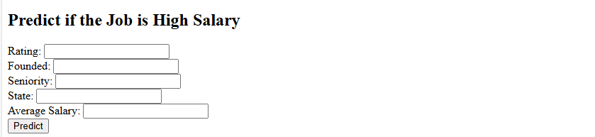
•Input:
• Rating: 4.2
• Founded: 2010
• Seniority: Senior
• State: CA
• Avg Salary: 105000
•Output:
• Prediction: High Salary
Web App
Page 11

Slide 12
Thank
You.
Thank
You.
Thank
You.
Page 12

